Slide 1
Basically Bill’s Various errors and how to deal with them
Advanced Data Analysis, Apr 23, 2019, Bill Yuanchen Liu
Breast Cancer Survival based on diagnosis reporting types,
a survival analysis

Slide 2
Contents
Background
Research question
Methods
Data cleaning
Descriptives
Analysis plan
Results
Table 1
Univariate
Multivariate
Survival
Discussion

Slide 3
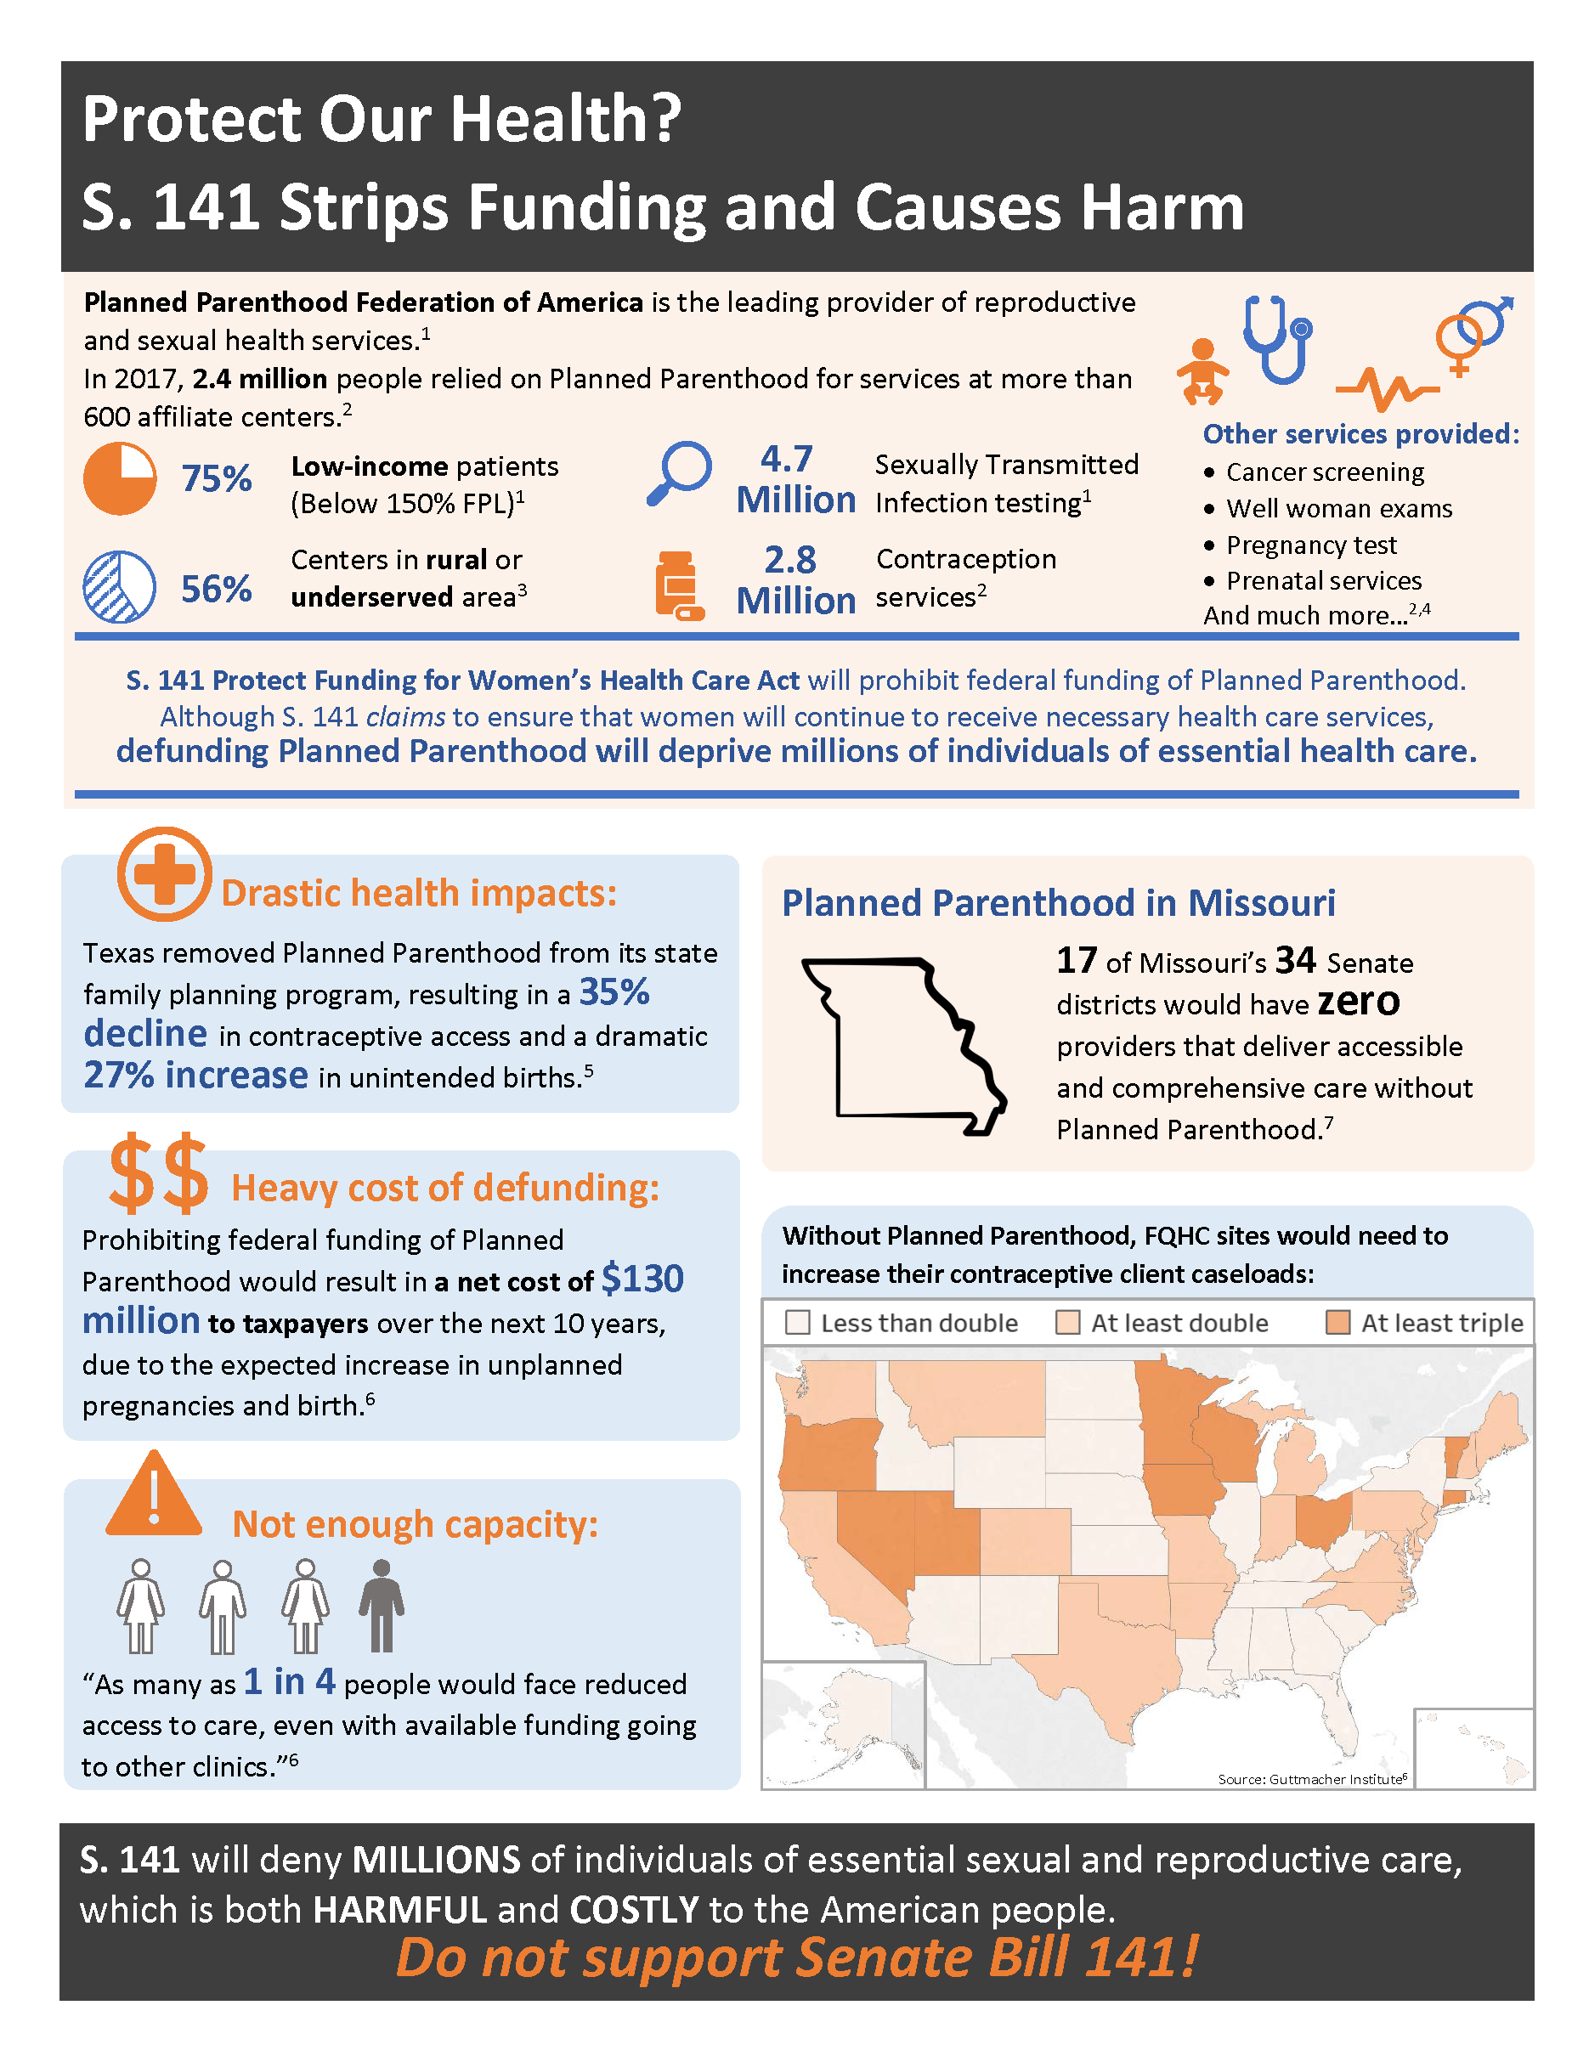
Background
On my DC Policy trip I advocated for Planned Parenthood.
Found that in some counties, PP are the only source of women’s wellness checks.
There is a major difference between quality of care offered at FQHCs and at PP.

Slide 4
Question
The objective of this study is to determine whether the different types of cancer diagnosis reporting source are associated with a difference in breast cancer survival in the U.S.

Slide 5
Methods: Data cleaning
SEER*Stat 18
Case listing session
Diagnosis and survival data, individual level
Variables
Survival, specific death, reporting types
Controls: diagnosis age, sex, race, insurance, stage
Preparing for MICE
Missing data
Preparing for coxph
Na.omit
Complete case data analysis

Slide 6
Methods: Descriptives
Package called “TableOne” is very handy

Slide 7
Methods: Analysis plan
Univariate coxph
Survival time, death event, reporting
Multivariate coxph
Age adjusted
Multivariate coxph
Control variables
Survival curves

Slide 8
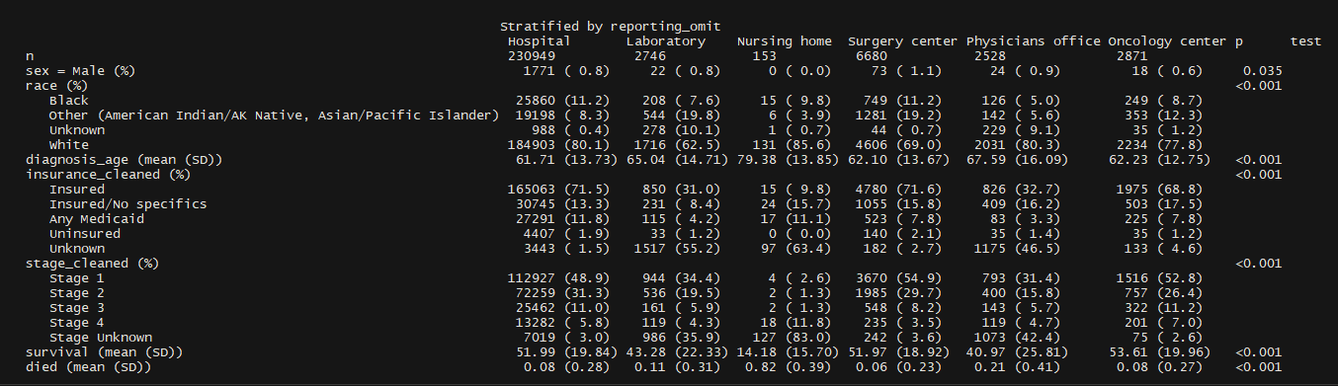
Results: Table 1, or should I call it… Tableone

Slide 9
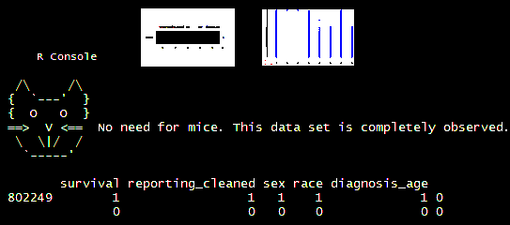
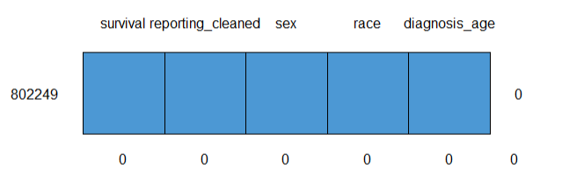
Results: MICE …no mice

Slide 10
Results: Univariate analysis
Hazard
P value
Laboratory
Nursing home
Surgery center
Physicians office
Oncology center
1.47
30.46
0.67
3.14
0.95
<.001
<.001
<.001
<.001
>.05

Slide 11
Results: Multivariate analysis age adjusted
Hazard
P value
Laboratory
Nursing home
Surgery center
Physicians office
Oncology center
1.43
24.74
0.67
3.00
0.94
<.001
<.001
<.001
<.001
>.05

Slide 12
Results: Multivariate analysis more robust
Hazard
P value
Laboratory
Nursing home
Surgery center
Physicians office
Oncology center
0.98
7.89
0.83
2.08
0.91
>.05
<.001
<.001
<.001
>.05

Slide 13
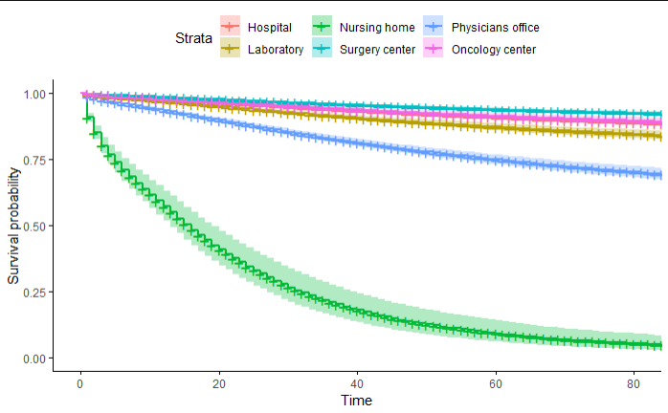
Results: Dem curves

Slide 14
Discussion: Method Limitations Inference
Multivariate and the problem of missing data
Rounding down the dataset
χ2 test and mediators, hypothesis testing
What is it about nursing homes?
Prioritizing checkup programs

Slide 15
Questions
?
Acknowledgements
Google
Package TableOne, Kazuki Yoshida
Dr. Johnson’s hour long help session
Kyle’s emails
My group mates in DC course

